Slide 1
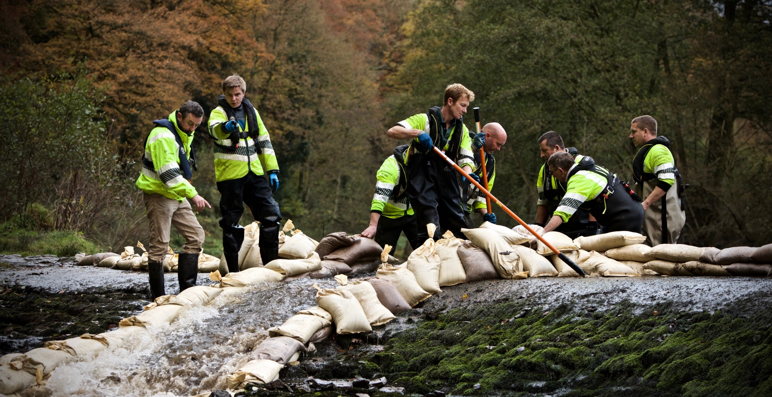
Director of Operations
- South and South West
September 2026
Recruitment Information Pack
GS reference: GSe129554.1
Application Deadline: 27/09/26 @ 23.59​
CONFIDENTIAL

Slide 2
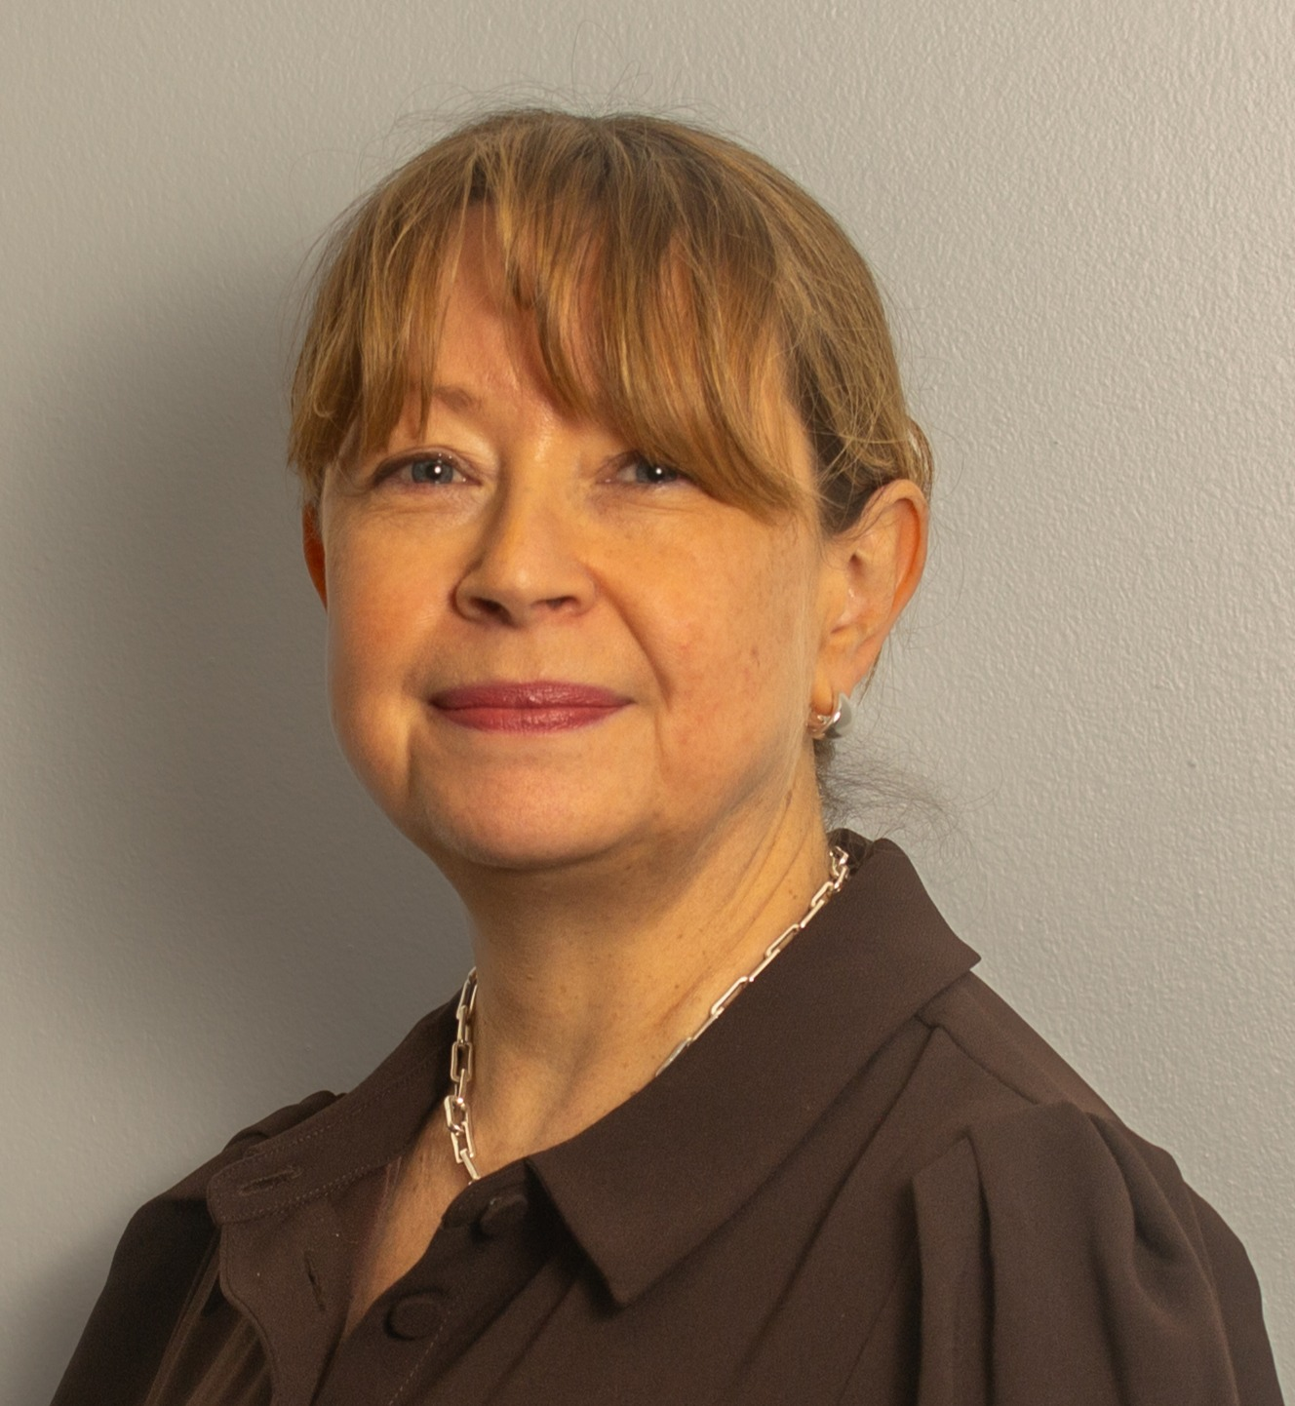
Welcome
Thank you for your interest in joining the Environment Agency.
We are an arms-length body of Defra family and play an important role in the resilience and prosperity of England. From climate resilience to clean land, air and water and enabling sustainable growth. Our work protects and enhances the environment while supporting sustainable growth, ensuring people, nature and businesses can prosper together.
As a regulator, we protect people and the environment by ensuring businesses meet standards for sustainable development and responsible growth. Our regulation is proportionate, efficient and easy to navigate. In return, we expect businesses to take meaningful action to reduce their environmental impact and fully meet their legal obligations.
As an infrastructure provider and asset operator, we deliver our ambitions through a prioritised investment programme. We maintain safe, compliant and resilient assets, backed by strong maintenance, contingency planning and continuous improvement. We also provide safe navigation services.
As an effective and efficient incident responder, we work with partners, so we are prepared for the biggest threats. We lead and coordinate response and recovery to incidents.
As an enforcement body, we tackle environmental crime by regulating key schemes, reducing waste, and addressing waste‑ and water‑related offences with partners. We use an intelligence‑led approach to target resources where threat and harm are greatest.
This is a vital time to work in Operations at the Environment Agency. Being part of the Environment Agency means being part of the solution. Working with us means protecting and improving the environment for generations to come, tackling issues of national importance across a variety of disciplines.
This is a unique opportunity to lead operations across the South and South West of England at a time of significant environmental challenge and opportunity. As Director of Operations, you will play a critical role in protecting communities, supporting sustainable growth and improving the environment for future generations. The successful candidate will bring extensive leadership experience in a large operational business, exemplary people leadership skills, and a track record of effective stakeholder management. This includes translating strategic thinking into effective delivery via transformation, innovation and improved productivity. I welcome fresh ideas and innovative thinking, as well as listening and learning about the organisation. You don’t need to be a technical expert, but you do need a passion for our mission!
I look forward to receiving your application.
Sarah Chare
Executive Director for Local Operations
Informal Discussions:
Candidates will have the opportunity to find out more about the roles at a virtual briefing session 18/09/26 at 11.30-12.15. For an invitation, please email:
devon.coates-leaning@gatenbysanderson.com
Please note that this not part of the formal assessment process; it is intended to give candidates the opportunity to learn more about the roles and the Environment Agency.
CONFIDENTIAL

Slide 3
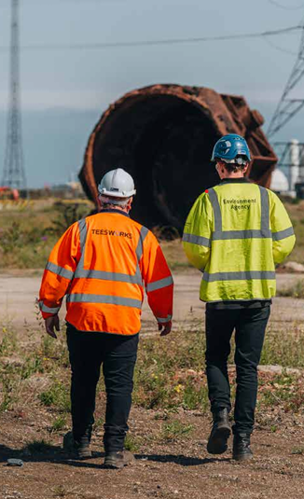
Our Organisation
We are the Environment Agency. We protect and improve the environment by creating places where people and nature can thrive. From tackling climate change and reducing flood risk to improving water quality and enabling sustainable growth, our work helps build a more resilient future for England.
We reduce the risks to people, properties and businesses from flooding and coastal erosion. We protect and improve the quality of water, making sure there is enough for people, businesses, agriculture and the environment. Our work helps to ensure people can enjoy the water environment through angling and navigation.
We look after land quality, promote sustainable land management, and help protect and enhance wildlife habitats. And we work closely with businesses to help them comply with environmental regulations.
We can’t do this alone. We work with government, local councils, businesses, civil society groups and communities to make our environment a better place for people and wildlife.
Our EA2030 strategy is the blueprint for how we'll transform as an organisation to meet the increasingly complex environmental challenges we face:
Healthy , land and water supporting nature's recovery- Protecting and enhancing our natural systems that provide the foundations for all life
Sustainable growth- Enabling economic prosperity that works in harmony with environmental protection
A nation resilient to climate change- Building adaptability to increasing environmental pressures and extreme weather events.
environmentagencycareers.co.uk
About us - Environment Agency - GOV.UK (www.gov.uk)
Gov.uk | Twitter | Facebook | LinkedIn | Instagram | YouTube
CONFIDENTIAL

Slide 4
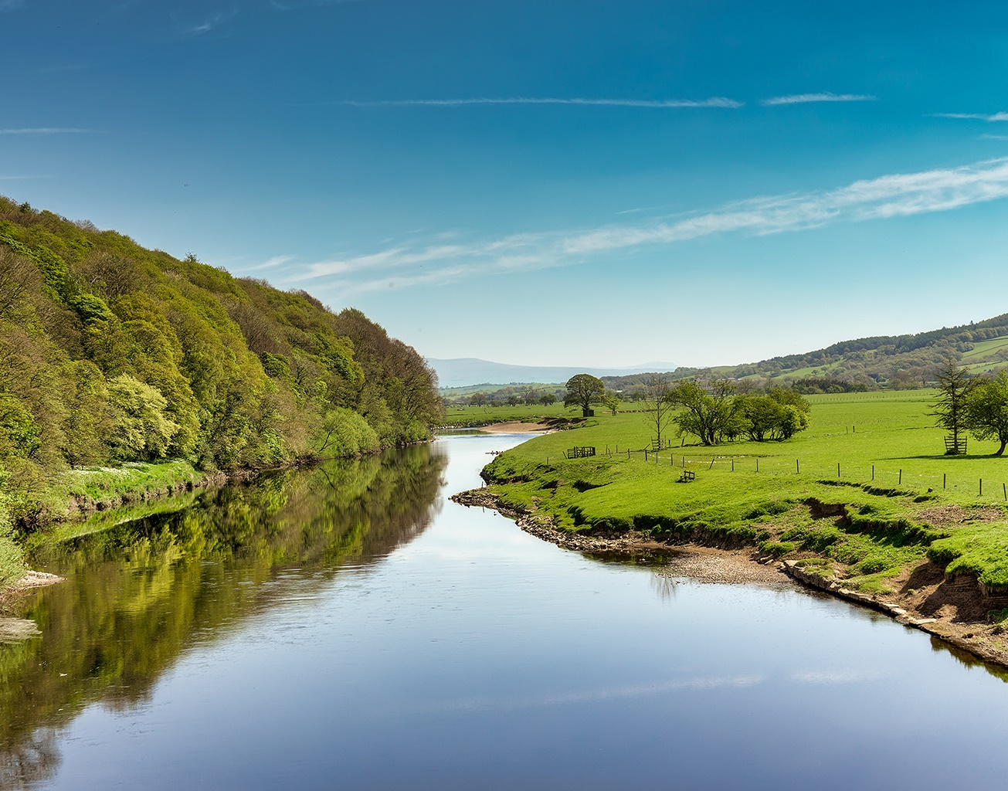
About the Role
Role Title: Director of Operations
Salary: £100,000 - £136,780
Location: South and South West
Contract Type: Permanent
Role Context:
We are looking for an exceptional leader who wants to help protect and improve the environment while shaping outcomes that matter to communities, businesses and nature. You will be a key player in helping us realise our 2050 vision for the environment across England – a place where air, land, and water systems are valued and sustainable, contributing positively to people, nature, and business. You will play a leading role in helping communities become more resilient, enabling sustainable growth, and protecting and improving the environment for future generations.
The Director of Operations, South and South West is responsible for 1,200 staff and significant budget. You will be responsible for setting direction, ensuring delivery and providing a strategic focus for the talented and purpose-led workforce across the South and South West hub. You will also be responsible for one of the national operational portfolios driving performance and assuring outcomes across the country.
You will be purpose-driven and customer-centric, engaging and serving our communities and partners with care. You will act with clarity, knowledge and conviction to ensure decisions are grounded in first-class evidence. You will be relentlessly efficient and effective at meeting performance targets, and adept at finding solutions to problems old and new through technology and change.
Responding to incidents is a central part of what we do. You will be required to have an incident role and make yourself available to respond to incidents or provide business continuity support during an incident.
CONFIDENTIAL

Slide 5
The vacancy
The South and South West hub has approximately 1,200 staff based in three operational Areas: Devon & Cornwall, Wessex and Solent & South Downs (which covers Hampshire, the Isle of Wight and Sussex).
The Director Operations for this hub will lead the Organisational Business national operational portfolio that oversees change implementation in operations and acts as client for our supporting corporate services. The Deputy Director for Operations Improvement Office and their team also reports to this role.
About national operational portfolios
Operational portfolios provide oversight, enabling us to organise ourselves better to support delivery. There are eight portfolios: Growth, Permitting and Monitoring; Incident Management & Resilience; Enforcement & Markets; Regulatory Compliance; Environmental Planning; Assets, Health and Safety; Organisational Business; Navigation.
The team
You will report to the Executive Director for Operations, and form part of a confident and purposeful team of senior leaders. You will be a member of our broader Environment Agency community of executive managers, and our national Director’s forum.
Your own team includes an Area Director for each Area in your hub, and a small executive office. The Director Operations South and South West also has the Deputy Director for Operations Improvement Office and their team.
Key Responsibilities
Working with elected leaders at a local and national level, up to Ministerial level.
Driving better performance and management of the business, including productivity, innovation and transformation.
Providing visible direction on the health, safety and wellbeing of our staff, contractors and the public.
Providing national leadership for delivery of your portfolio, working as ‘one team’ across the organisation. Directors are wholly accountable for decisions within their work areas, but this must be balanced with a proven ability to work closely and constructively with colleagues and to contribute to and promote shared decision making.
Influencing our strategic direction to ensure achievement of our corporate strategy and environmental outcomes.
Directors take a shared lead in managing national incidents and emergencies. Experience of crisis and emergency management, re-prioritising resources, working under pressure and at pace during national situations is preferable, but training will be provided.
Building a vibrant culture in which all the Environment Agency’s staff feel valued and focused to achieve great things.
Enabling our people to do more for the environment by evolving our culture, investing in capability and growth, valuing diversity and promoting wellbeing and inclusivity.
CONFIDENTIAL

Slide 6

Person Specification
The successful candidates will possess the following skills and experience.
Essential Criteria:
Extensive senior leadership experience, ideally at Director level, in a large operational business. This includes evidence of translating strategic thinking into effective delivery via transformation, innovation and improved productivity.
A record of leading at an appropriate scale (leading 100+ staff), exemplary management skills and high levels of energy, with a proven record of motivating staff to perform to the highest level.
Strong political awareness, with the ability to work effectively in partnership with local leaders, Mayors, MPs, local authorities, Government departments, industry and regulatory bodies.
Excellent judgement and resilience in managing complex, high-profile issues and balancing multiple stakeholder interests. The ability to challenge where necessary, deal effectively with ambiguity and make difficult decisions, often under pressure and time constraints.
A demonstrable ability to deliver large scale, high impact and complex work at pace.
A strong communicator, comfortable operating at all levels, internally and externally, with experience of presenting to influential audiences including elected leaders.
An understanding and appreciation of issues relevant to the Environment Agency.
A proven and demonstrable track record in creating a culture which values diversity and promotes wellbeing and inclusivity. We need leaders with a diverse range of backgrounds and experiences, who can help realise the potential of all our staff and ensure we deliver equitable services to all our customers and communities.
CONFIDENTIAL

Slide 7

How to Apply
GatenbySanderson are managing this campaign on behalf of the Environment Agency. To apply for this posts, please submit the following through the online link www.gatenbysanderson.com/job/GSe129554.1
This should be completed no later than 23.59 on 27 Sept 2026.
The application must include:
A CV (no longer than 2 pages) setting out your career history, with key responsibilities and achievements. Please ensure you have provided reasons for any gaps within the last two years.
A Statement of Suitability (no longer than 2 pages) explaining how you consider your personal skills, qualities and experience provide evidence of your suitability for the role, with particular reference to the essential criteria in the person specification.
Responses to the following questions (no more than 1 page combined total):
Describe an example of where you successfully influenced senior external stakeholders, such as elected representatives, government officials, regulators, industry partners or community leaders, to achieve an important organisational objective. What approach did you take and what impact did it have?
The Environment Agency works at the intersection of environmental protection, public service and sustainable growth. Describe a time when you balanced operational performance with wider social, environmental or public outcomes. What challenges did you face and what was the result?
Failure to submit all documents will mean the panel only have limited information on which to assess your application against the criteria in the person specification.
As part of the online application process, you will be asked a number of diversity-related questions. If you do not wish to provide a declaration on any of the particular characteristics, you will have the option to select 'prefer not to say’. All monitoring data will be treated in the strictest confidence.
Should you encounter any issues with your application please contact:
Devon.coates-leaning@gatenbysanderson.com
For a confidential discussion to help inform your application, please contact our recruitment advisors at Gatenby Sanderson:
Russell Brandon – Russell.Brandon@gatenbysanderson.com
Olivia Robinson – Olivia.Robinson@gatenbysanderson.com
Michelle Atkinson – michelle.atkinson@gatenbysanderson.com
Security vetting
All candidates will need to undergo a security check as part of the Environment Agency’s pre-employment checks. You can find out more about the different types of security checks.
If successful you must hold, or be willing to obtain, security clearance to SC level (Director of Operations – South and South West).
More information about the vetting process can be found here .
CONFIDENTIAL

Slide 8
Indicative Timetable
Closing Date for Applications​ | Sunday 27th September @ 23.59​
Longlist Meeting​ | Friday 2nd October ​
Preliminary discussions with GatenbySanderson​ | Week commencing 5th October​
Shortlist Meeting​ | Friday 16th October​
Assessments​ | Week commencing 19th October ​
Final assessments​ | Friday 30 October 2026​
Appointment Expected​ | ASAP​
We will try and offer as much flexibility as we can, but it may not be possible to offer alternative dates for assessments or interviews. You are therefore asked to note the below timetable, exercising flexibility through the recruitment and selection process, in order to meet the dates given.
Please note that these dates may be subject to change.
CONFIDENTIAL

Slide 9
The Selection Process
Longlist
The vacancy holder will assess your application to select those demonstrating the best fit with the role by considering the evidence you have provided against the essential criteria set out in the ‘Person Specification’ section. Failure to address any or all of these may affect your application. ​
Candidates selected for longlisting will be invited for a Preliminary Interview with GatenbySanderson to further explore their skills and experience.​
Candidates applying under the Disability Confident who meet the minimum selection criteria in the job specification are guaranteed an interview.
Shortlist
The vacancy holder will review reports on those longlisted and will select a shortlist of candidates whose applications best demonstrate suitability for the role, by considering the evidence provided against the essential criteria set out in the Person Specification.
Assessment
Shortlisted candidates will be asked to complete psychometric assessments in advance of final interview.
Final Interview
You will be asked to attend a panel interview in order to have a more in-depth discussion of your previous experience and professional competence in relation to the criteria set out in “The Role” section. The interview panel may give a presentation topic to candidates for preparation ahead of the interview.
The interview day will also include:
- A scenario exercise
A staff engagement exercise
Interviews are schedule to take place in person in Birmingham.
Further details will be provided to shortlisted candidates. It is unlikely to be possible to secure alternative dates for interview but do highlight any availability issues on your application.
Outcome and Feedback
The timeline in this pack indicates the date by which decisions are expected to be made – all candidates will be advised of the outcome of their application as soon as possible thereafter.
Unfortunately, we are only able to offer feedback to candidates who are shortlisted and attend interview. Candidates who pass the interview, but are not offered a post, may be kept on a reserve list for 6 months for similar roles that arise.
CONFIDENTIAL

Slide 10

The Selection Process (continued)
Disability Confident Scheme
We are committed to the Disability Confident Scheme. We guarantee an interview for any person with a disability, defined by the Equality Act 2010 if:
They have a physical or mental impairment;
The impairment has a substantial and long-term adverse effect on their ability to perform normal day-to-day activities.
This positive action policy provides disabled applicants (which can include neurodiverse people and people with hearing loss and visual impairment) with the opportunity to demonstrate their abilities beyond the initial application stage by offering an interview providing the candidate meets the ‘minimum criteria’ for the job. By ‘minimum criteria’ the applicant must provide us with evidence in their application form which demonstrates that they meet the level of competence required for each essential competency, as well as meeting any of the qualifications, skills or experience defined as essential. To apply under this scheme, please go to the “Equality and Diversity” section of your online application.
Please note: the Disability Confident Scheme secures an invitation to interview, providing you meet the minimum criteria, it does not guarantee a job. At interview, all applicants will be marked solely on merit.
Reasonable adjustments
Interview Stage: Candidates will be asked about any workplace adjustment that they might require during the interview process. This may include, for example, written version of interview questions, use of specialist software or additional time to complete an exercise, use of a sign language interpreter if a candidate is deaf.
On Appointment: Any workplace adjustments you require will be discussed and put in place before you start work.
CONFIDENTIAL

Slide 11
Terms and Conditions
Salary band: £100,000 - £136,780
Location: It is preferred that the post holder lives within the hub they lead (South and South West). Travel is required including frequent travel to London and Birmingham.
Hours of work: 37 hours
Contract type: Permanent
Leave entitlement
Your leave allowance in this role will be 27 days or equivalent, depending on working pattern, plus bank holidays. Your allowance will be pro-rata if you work part time, or you are on an assignment to a role at a higher grade that attracts an increased entitlement. Your entitlement depends on your grade, your contracted hours, and your length of continuous service.
We offer up to two days paid environmental outcome days each year. These give you the opportunity to take part in community activities with a clear environmental outcome for people and wildlife.
Enhanced maternity, adoption and paternity leave, and sickness absence provisions are available.
Additional paid leave is available for employees taking part in public duties, trade union activities, special/trained forces and for health and safety representatives.
Work/life balance
We support and encourage flexible working hours and practices at all levels to help you achieve a good balance between your work life and your personal life. We will encourage you to keep developing your skills and professional knowledge throughout your career.
Pension
We will enroll you into the Environment Agency Pension Fund (EAPF) on commencing employment if your employment contract is for 3 months or more. The EAPF is part of the Local Government Pension Scheme (LGPS). It is a career average scheme, which means you will build up benefits based on your pay each scheme year rather than your final salary.
We will base your pension contributions on your actual pay and you will receive tax relief on your contributions. The pension contribution rates currently range between 5.5% to 12.5%. Whilst you are in the scheme, we will pay an employer contribution into your pension pot. We currently pay 19%, so this is a very generous scheme.
Relocation
For eligible roles, we may be able to offer financial assistance with the cost of relocation. This is normally in cases where the role is critical to the delivery of our business and where the vacancy has proven hard to fill due to scarcity of the required specialist, niche, or technical skills available in the market. Please speak to the hiring manager through the details provided in the advert to discuss whether the role you are applying for fits into this category.
Relocation support is not guaranteed and will be discussed upon request subject to you being offered a post with us.
CONFIDENTIAL

Slide 12
Future Incident Response
Incident response has many rewards, including financial benefits for out of hours work. It provides our people with opportunities to develop new skills and work in a dynamic environment alongside new colleagues, local communities, and emergency response partners. We want the Environment Agency to be a life enhancing place to work. We will work with you to ensure you are able to participate in a way that suits you and supports a healthy work-life balance.
The Environment Agency is committed to be an inclusive employer. To achieve this in our incident roles workplace adjustments are available to support those with additional support needs, for example colleagues with a disability or a neurodiverse condition and/or colleagues with caring responsibilities.
Incident response is an integral part of what the Environment Agency does. Our remit is wide ranging, and we are responsible for many incidents that affect the natural environment, human health, and property in England. When incidents happen, we strive to keep people safe and minimise serious and lasting damage to the environment and the communities we serve.
Everyone that joins us will undertake training and participate in our incident response. There are many exciting roles you could be doing anything from being on the scene of a waste fire advising the emergency services, to gathering and reporting vital information while working from home or one of our offices, visiting communities to warn and inform people about flood risk, providing specialist advice, or ensuring that urgent work in your team or department continues whilst your colleagues respond to incidents.
Some of our staff are required to carry out an incident role that involves being on on-call (standby) to work out of hours, this is usually 1 in every 8 weeks. Other incident roles are activated when they are needed. For these you will be given notice beforehand and have some flexibility on when and how you contribute. We want you to develop skills and feel confident in your incident role and will provide you with all the relevant professional training and peer support you need to deliver it.
CONFIDENTIAL

Slide 13
Eligibility
Eligibility to apply and continuity of employment
Employment agency workers and contractors are considered to be external candidates and should therefore only apply for positions that are being advertised externally. They are not eligible to claim continuity of employment should they be successful in securing a position with the Environment Agency.
If you have been a member of a Regional Flood and Coastal Committee (RFCC) in the last 12 months, we will not be able to continue with your application based on agreed appointment rules related to employing ex-RFCC members. We would welcome an application from you once the 12-month period have passed.
For applicants who currently work in local government or other bodies listed in the Redundancy Payments (Continuity of Employment in Local Government etc.) (Modification) Order 1999, you may be eligible for continuous service for the purpose of calculating any future redundancy payment.
In addition, if you can demonstrate that you have worked at the Environment Agency immediately before joining the Civil Service and are now being re-employed by the Environment Agency within a period of three years of leaving, you may also count your Civil Service employment for the purpose of calculating your service-related entitlements as outlined above. If you are unsure of your status, you should contact your own HR Team.
Right to work and eligibility for employment
Before applying, it is the responsibility of all candidates to ensure they have the correct right to work documentation. If you require sponsorship, please ensure that the position you apply for meets the UK Visa & Immigration (UKVI) requirements. If selected, your appointment would be subject to you obtaining and maintaining the relevant work visa terms and conditions set for you by UKVI.
Skilled worker visa
For candidates looking to obtain a certificate of sponsorship and a skilled worker visa. In line with our allocation framework, we will consider requests for sponsorship subject to the candidate holding a current alternative visa due to expire within 3 months or in cases where the candidate does not have any other visa options to pursue other than skilled worker visa sponsorship.
Candidates note, even if successful in post, EA cannot guarantee if a certificate of sponsorship can be issued as this will depend on the role and personal circumstances satisfying UKVI eligibility and availability of sponsorship certificates we are able to issue.
Pre-employment checks
We apply the Baseline Personnel Security Standard (BPSS) check when recruiting employees to our posts. This includes a basic criminal records check.
For the great majority of roles in the Environment Agency this will be sufficient but for this role you must hold, or be willing to obtain, security clearance to SC level.
Want to find out more?
To find out more about what it’s like to work at the Environment Agency, please visit: environmentagencycareers.co.uk/working-here
CONFIDENTIAL

Slide 14
Further Information
EA People Strategy Ambitions
We want to be an employer of choice with excellent employee satisfaction, an inclusive, positive workplace culture and expanded personal development opportunities as evidenced by our 5 key overall ambitions:
Strengthening our employee offer
Investing in capability and growth
Valuing diversity and promoting wellbeing and inclusivity
An HR service that delivers strong foundations and empowers our people
Unlocking organisational potential
Flexible working
We will consider flexible working patterns for all our vacancies, including job share, so please let us know more at the assessment stage of the process.
Disability leave
Disability leave is a workplace adjustment to help you manage your disability at work. You may need additional time off to support you with the assessment, treatment or rehabilitation for your medical condition and disability leave is designed to cater for this.
If you have a “physical or mental impairment that has a substantial and long-term negative effect on your ability to do normal daily activities” (Equality Act 2010) you may be eligible to request disability leave. This can include neurodiverse people and people with hearing loss or a visual impairment.
Employee networks
We have an increasing number of employee networks and forums that support our employees and help us build an inclusive culture.
Diversity and inclusivity
The Environment Agency values a diverse workforce and welcomes applications from all sections of the community who wish to join a workforce which values difference and welcomes everyone.
We aim to create and maintain a diverse workforce (including our Board and Executives) that better reflects the UK’s economically active population. We recognise the challenges that individuals with (multiple) protected characteristics may experience in the job market. We are committed to being an inclusive employer and ensuring equal opportunities. Therefore, we particularly welcome applications from people from ethnic minority backgrounds; people with a disability; female; those part of the Lesbian, Gay, Bisexual and Transgender community (L.G.B.T+); gender diverse people, and candidates from lower socio-economic backgrounds who are under-represented across our workforce.
We will consider flexible working patterns for all our vacancies, including job share.
We recruit based on merit. This means our selection process is designed to be fair, open and equal.
Our Guiding Principles
We recognise the need to evolve how we work. Our six guiding principles help us navigate the complex challenges we face:
Act with clarity
Act with knowledge and conviction
Focus on efficient and effective delivery
Find solutions to problems old and new
Work more closely with partners
Serve with care
CONFIDENTIAL

Slide 15
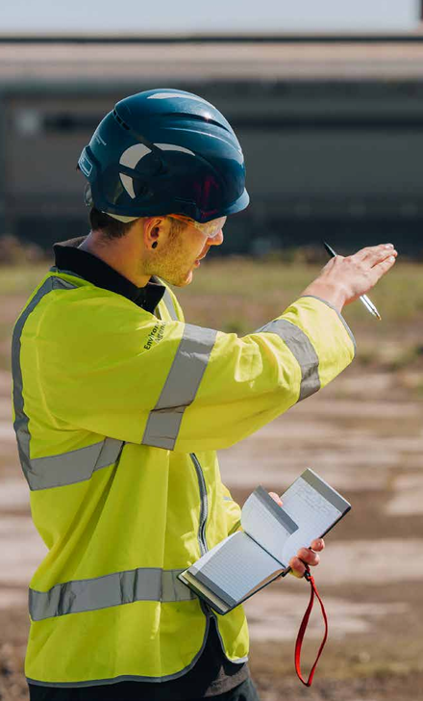
For a confidential discussion to help inform your application, please contact our recruitment advisors at GatenbySanderson:
Russell Brandon – Russell.Brandon@gatenbysanderson.com
Olivia Robinson – Olivia.Robinson@gatenbysanderson.com
Michelle Atkinson – Michelle.Atkinson@gatenbysanderson.com
CONFIDENTIAL

